Slide 1
Economics of Tyre Market
GROUP 32

Slide 2
INDEX
Overview
GDP
Circular Economy
Market Division
India vs Global
Strategies
Demand-Supply
Competition
COVID
Dependent Good
Import/Export
Future

Slide 3
Overview
We present a point by point analysis of the key trends, opportunities, challenges, and growth drivers of the tyre market and the economics associated with it.

Slide 4
Understanding the market

Slide 5
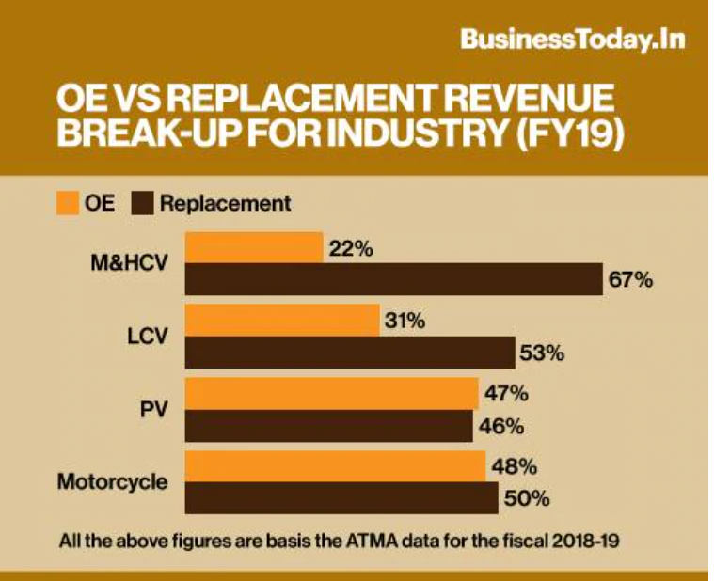
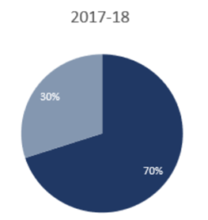
Market division
The demand for tyres originates from two types of end users
OEMs and
replacement market
The Indian tyre market is dominated by demand from the replacement segment, contributing around 70 percent of the total volume, while the remaining 30 percent is accounted for by OEMs.
https://www.alphainvesco.com/blog/understanding-the-indian-tyre-industry/#:~:text=Indian%20tyre%20industry%20has%20almost,share%20in%20terms%20of%20revenue
https://www.businesstoday.in/sectors/auto/tyre-war-apollo-wants-to-overtake-mrf-and-become-india-largest-tyre-maker-by-2021/story/378894.html

Slide 6
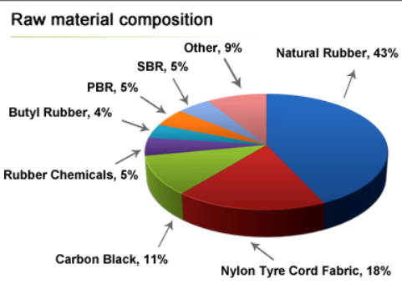
Demand and Supply
Around 250 raw materials are put together to make a simple tyre, from which very few are cost generating.
ICRA said "Tyre demand is estimated to grow by 7-9 per cent over the next five years (FY 2019-23) supported by favourable outlook for the domestic automotive industry." Expanding automobile industry and increasing automobile sales are major factors which boosts demand for tyres in India.
Link

Slide 7
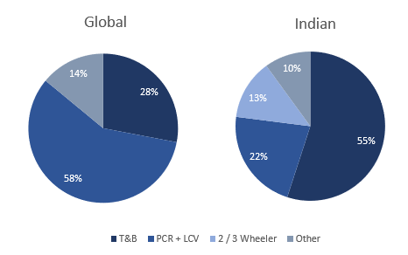
GDP contribution:
Tyre industry contributes to ~3% of manufacturing GDP and ~0.5% of total GDP.
Tyre industry has grown as much as 2 times from 2010 -11 to 2017-18 from Rs.30000 Cr. to Rs. 59,500 Cr.
Truck and bus tyres contribute to 55% of total production. While passenger vehicle tyre contributes 22%, 2/3 wheeler vehicle 13% and other types of vehicle 10% of total production.
https://www.alphainvesco.com/blog/understanding-the-indian-tyre-industry/#:~:text=Indian%20tyre%20industry%20has%20almost,share%20in%20terms%20of%20revenue

Slide 8
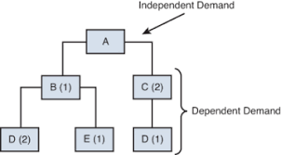
Tyres as Dependent Demanded Goods
Price of the other Goods, which is not associated as raw goods to this market may impact upon tyre markets
Tyre stock market is much more complex due to its dependencies.
Countries who produces tyres, their automobile industry is less impacted by changes made in tyre markets but countries which imports tyres, they have larger impact upon country’s automobile industries (Example: India/Bangladesh).
link

Slide 9
Indian Tyre
Industry

Slide 10
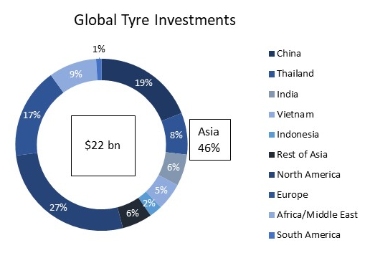
India vs Global
Overall Asian economies accounted for ~50% of the global sales and China is the world largest tyre market. Europe, the United States, India and Japan are other leading countries for tyre manufacturing.
01 | The global tyre market reached a total volume of 3.2 Billion Units in the year 2019, growing at a CAGR of around 4% during 2014-2019, and is expected to reach a volume of 4.2 Billion Units in the year of 2025.
02 | Indian tyre industry is expected to see a growth of 7-9% in demand in the period of 2020-25.
Image source

Slide 11
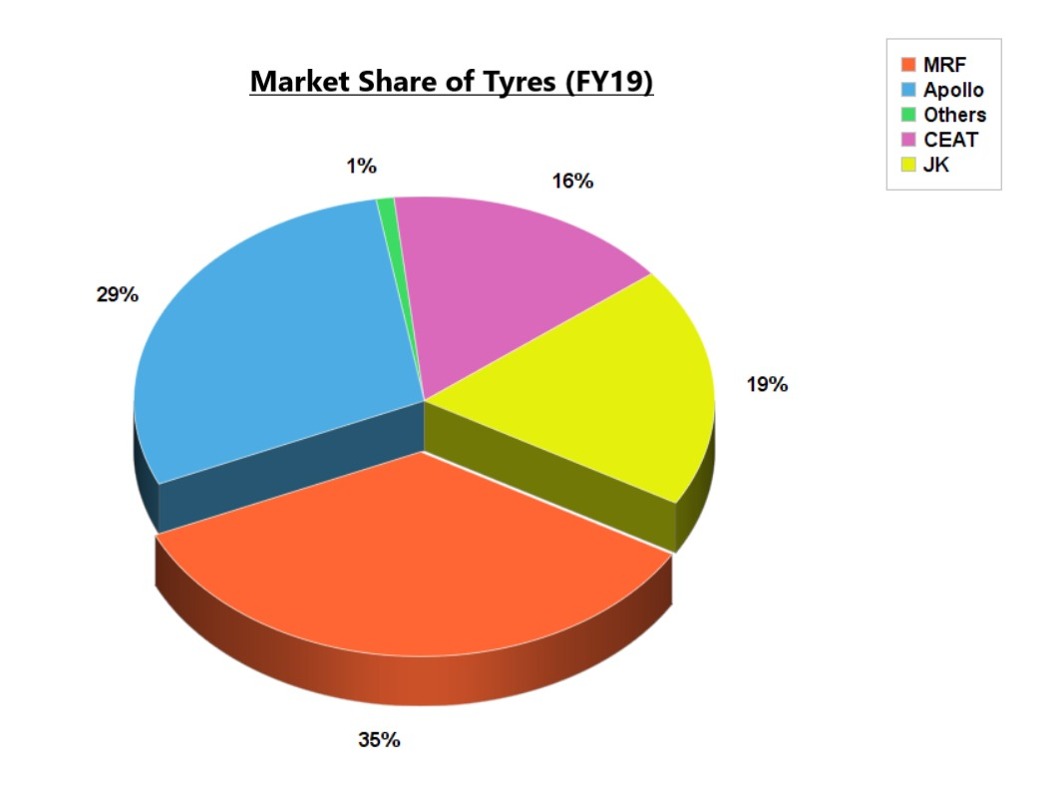
Competition in India
MRF has been the leading Indian tire manufacturer for more than three decades.
Apollo has emerged the strongest contender for market leadership, and has grown its revenue by almost 40% in past four years.
JK Tyre, India’s biggest commercial vehicle tyre manufacturer is depending on the growing replacement market.

Slide 12
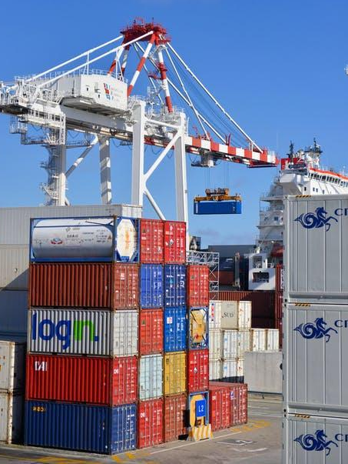
Government Policies and Import/Export
Import duty changed over time from being liberal to strict and again shifting towards a more liberal approach while encouraging export. India, at present, exports to over a 100 countries.
Currently, finished products can be imported at a much lesser duty (<10%) than Natural Rubber (~25%) which is the primary raw material and short in supply in India. This is one major factor hindering domestic manufacture.
Image source

Slide 13
Present
and Future

Slide 14
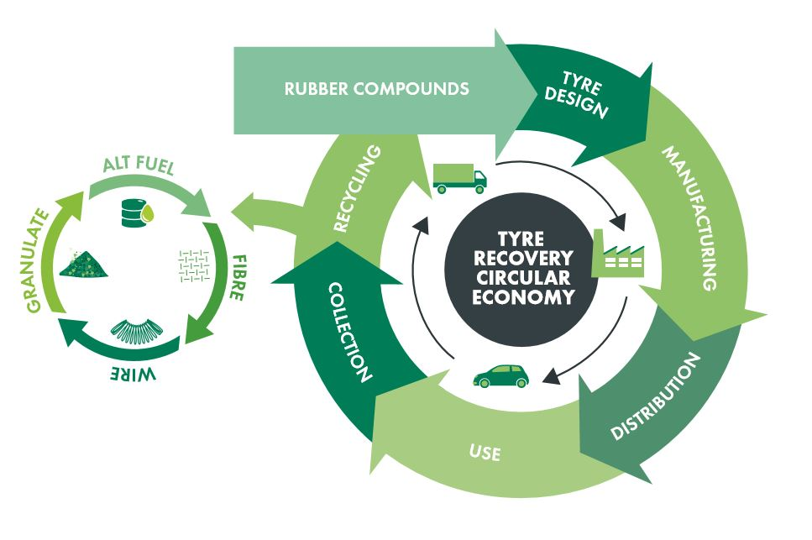
Circular Economy
Focuses on reducing wastage and sustainable and longevity of products because every year millions of tons of used tyres are discarded as waste.
Retreading is an ideal example of the circular economy as it diminishes roughly 160 kg of waste for each tire retreaded twice and saves 104 kg crude materials, all while accomplishing CO2 reserve funds.
It will keep a check on the demand-supply equilibrium by ensuring continuous supply.
https://tyrerecovery.org.uk/know-tyre-waste/circular-economy/

Slide 15
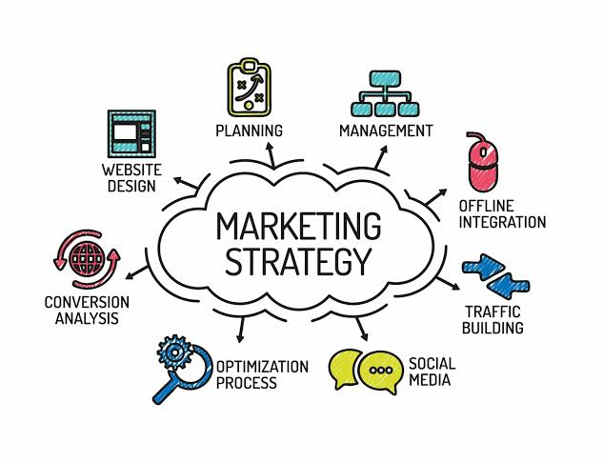
Marketing Strategy
APOLLO
Product Leadership.
Customer intimacy.
Operations excellence.
MRF
Masters at Pull strategy.
Publicity campaigns and ATL promotional methods.
Pioneered the practice of heavy advertising and promotion in the tyre industry.

Slide 16
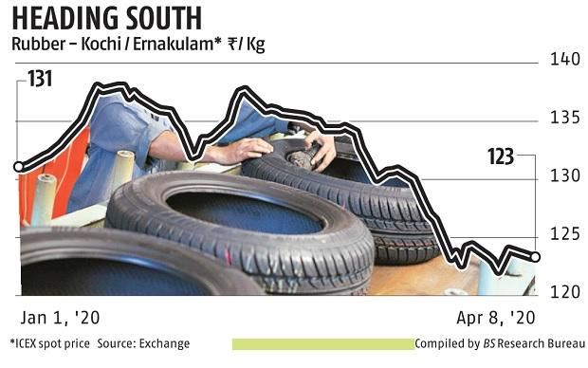
Covid Effects
The industry faces problems on the supply part and the product manufacturing momentum. So the result of this tyre industry revenue is estimated to grow at a lower rate of 3-4 percent in FY2020 in comparison to FY2019 and FY2018.
There will be a major growth shown in domestic tyre industries. Despite the pandemic there will be continuous demands of tyre from the rural and semi urban areas.
According to MRF, some experts estimate that auto industry volumes will be down by 25% in financial year 2021.

Slide 17
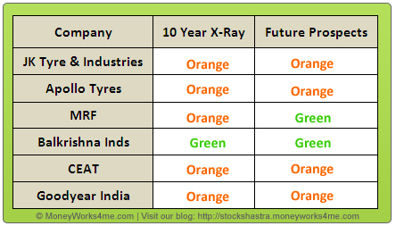
R&D , Growth
Indian tyre industry has made remarkable progress in recent years.There is one image which shows some company’s progress and its future.
Growth of automobile industry,capacity expansion,large distribution,increment in the use of radial tyres are some main factors which are responsible for the growth of tyre industry.
If we tackle upcoming challenges like competition with low cost manufacturing tyre countries,volatility in price of raw materials,higher interest rate very carefully then tyre industry’s future looks very bright.

Slide 18
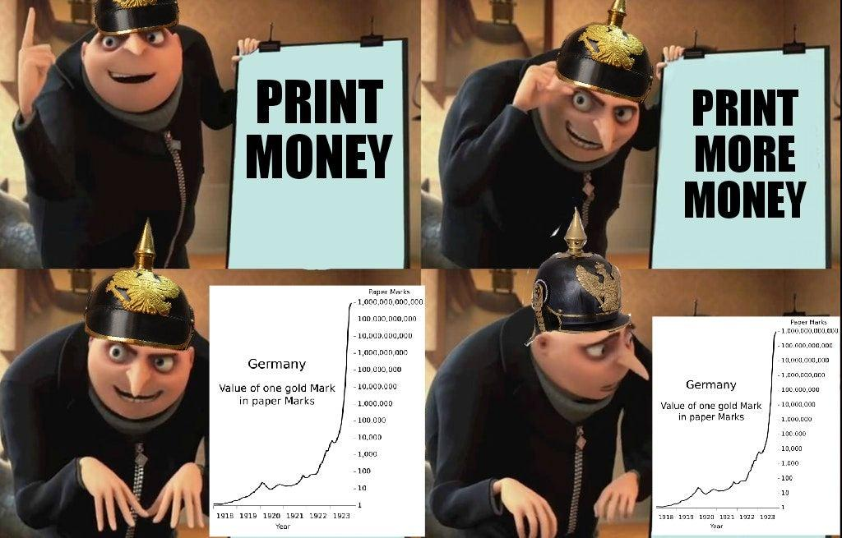
Fin.

